Slide 1
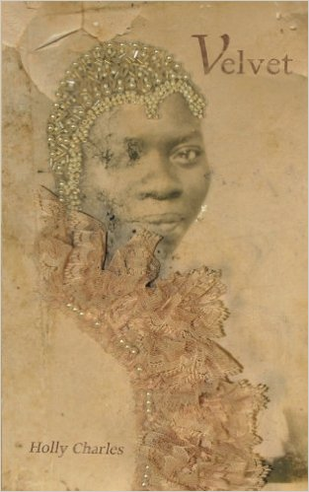
Being My Mother’s Daughter
Holly Charles, M.A.
TEDxRice
Feb 16th, 2019

Slide 2
Who Am I?
Educator
Christian
Woman
Author of Velvet
Playwright
American
African American

Slide 3
I am my mother’s daughter.

Slide 4
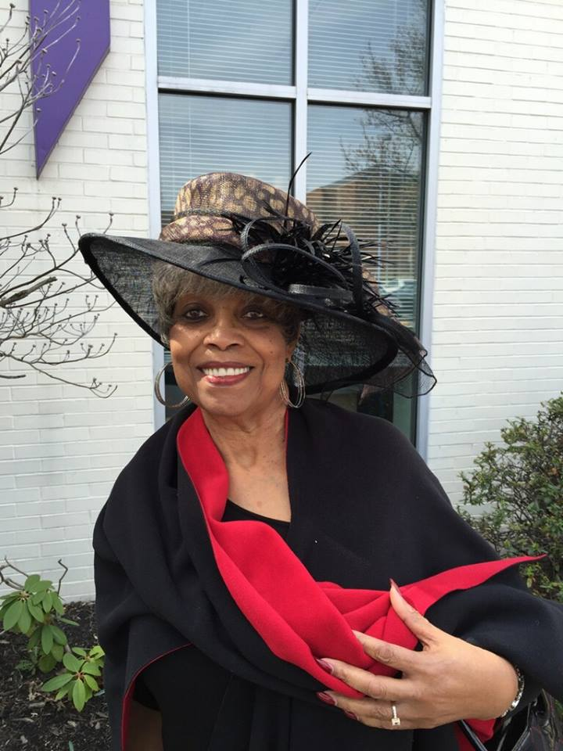
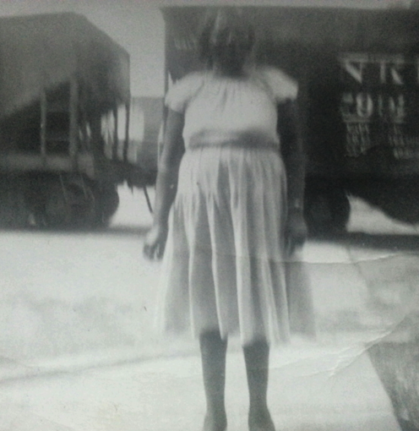
Spring 2013
My grandmother, Nellie
My great-grandmother, Ludie

Slide 5

Black Motherhood
Patriarchy
Racial Hierarchies
Socioeconomic Status

Slide 6



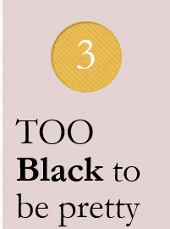
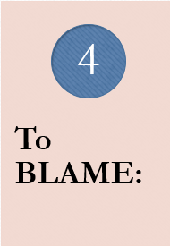

In the 1920s, what does a poor, young Black girl from rural Texas, like my great grandmother, know about herself?

Slide 7
“People will see the worst of the best picture you paint.” - Ludie
So, she began to LIE to others
About the child she bore
About where she came from
About whatever might make people dismiss her more that she already had been
So, she began to LIE to herself
Her dark, velvet skin was not beautiful

Slide 8
Questions
How could she value herself when the world did not?
How does she teach her daughter to value herself?

Slide 9
Was Ludie a liar?
OR
Was she passing down her best version of the TRUTH?

Slide 10




What is my own TRUTH?

Slide 11
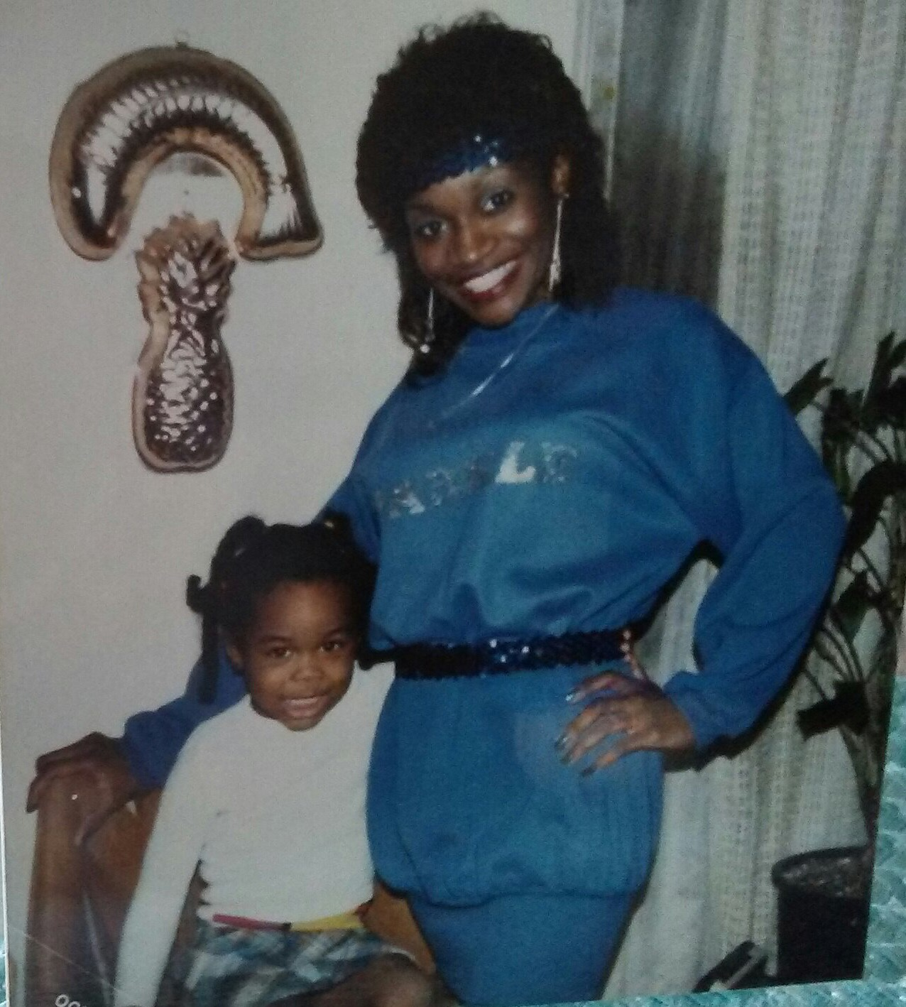
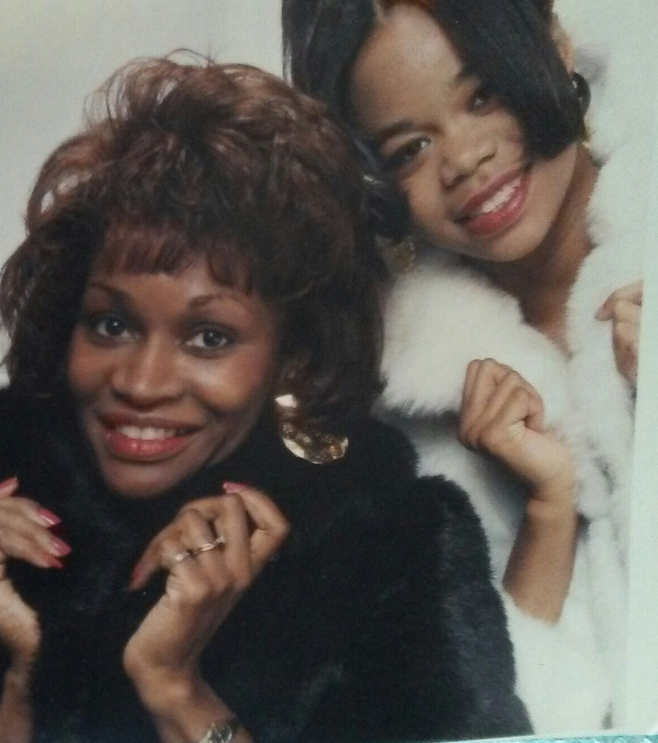
Back to the Beginning

Slide 12



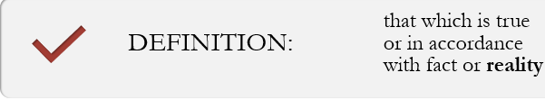

So, What EXACTLY is TRUTH?
**Excerpt from Velvet (2013), Chapter Title: My Mother’s Wedding Dress

Slide 13
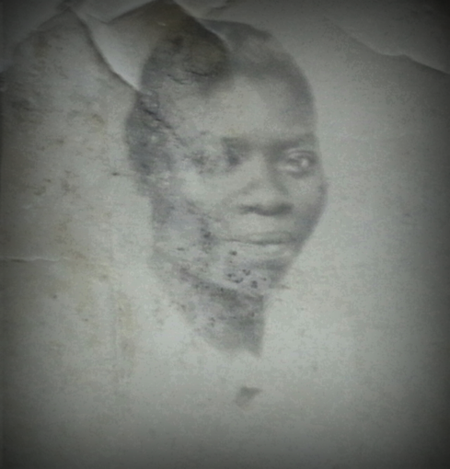
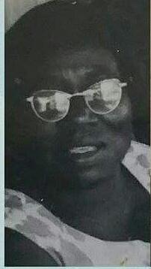
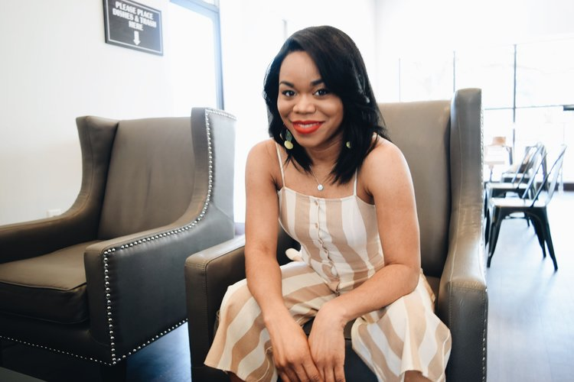
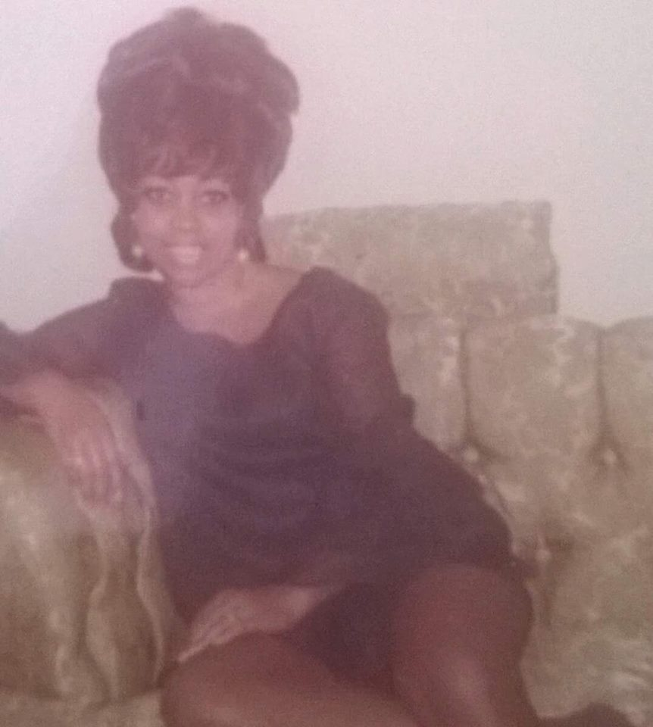
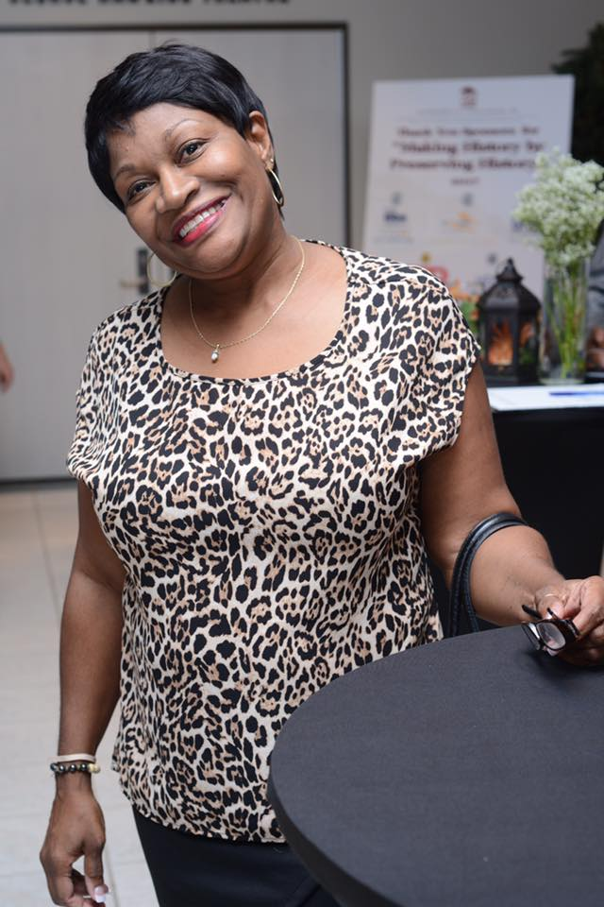
Each Woman Carries Her Own Reality & Truth
**The REALIZATION: Thesis Writing Experience

Slide 14

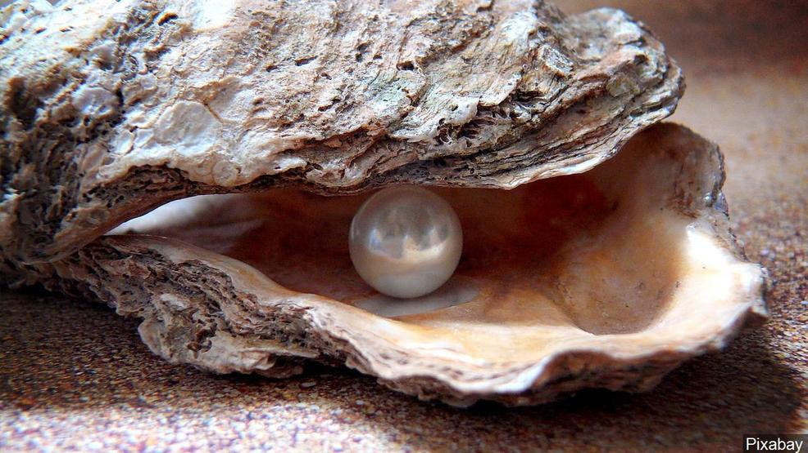
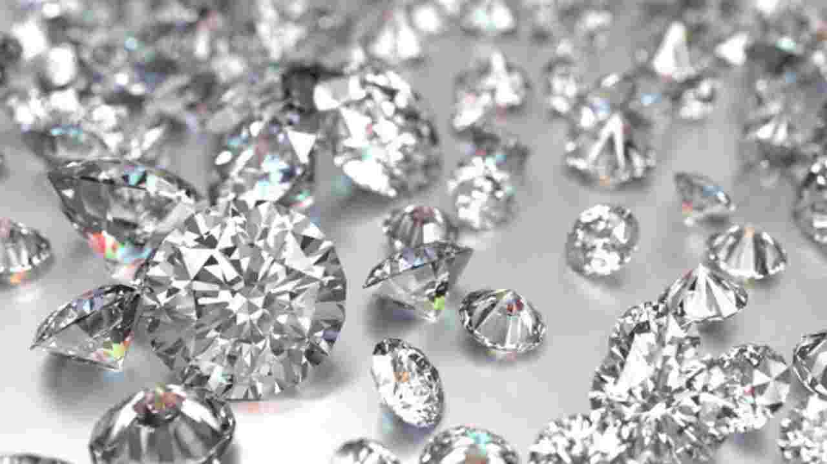
THESIS: A mother can only mother based off of her fears and experiences.
Fin24.com
Pixabay via MGN Online
Getty Images

Slide 15
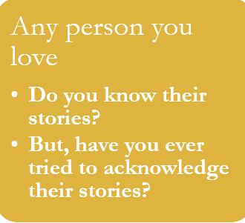
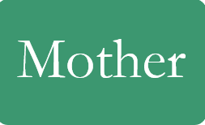



Knowing vs Acknowledging

Slide 16

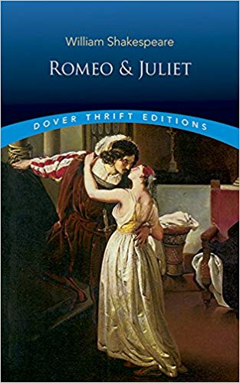
Cliff Notes vs The Book
Are you just reading the blurb on the back of the book?
Have you read the book from cover to cover?
Do you know their story?
Or have you taken the time to acknowledge their story?

Slide 17
The Fall

Slide 18
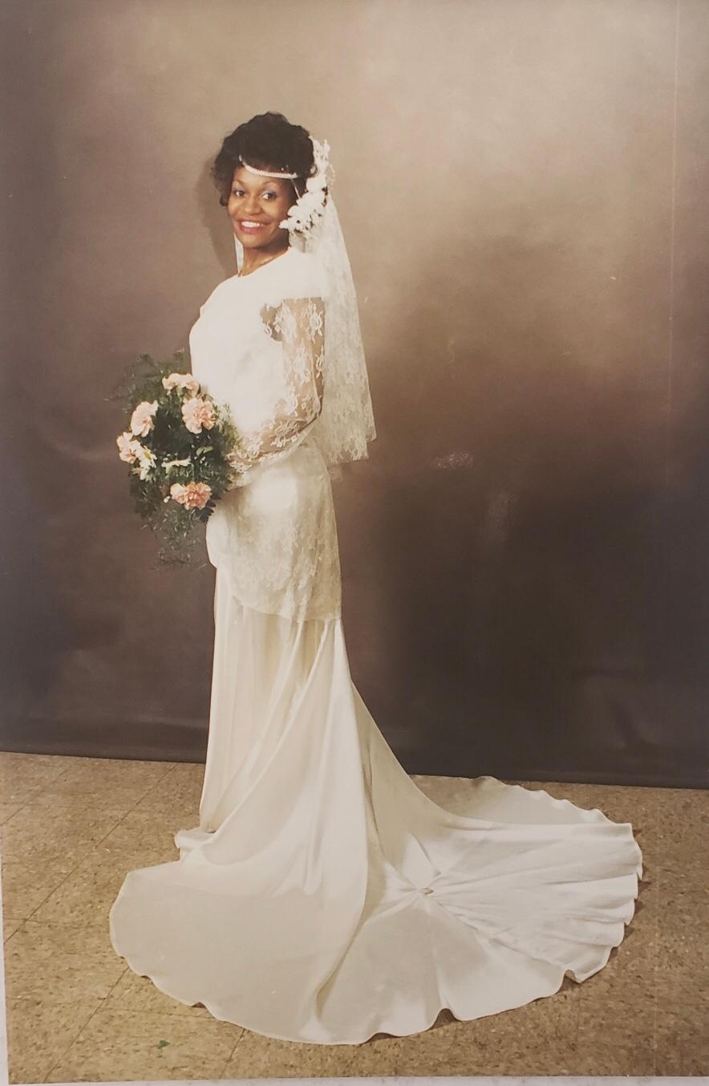
Despite All…
Patriarchy
Racial Hierarchies
Socioeconomic Status
Fears
Experiences
Spiritual Heirlooms
Generational Curses

